Slide 1

UJ Sport Athlete and Booking Management System
Team 26: Mint
Team Members 220046244 – Pashin Soma
221060349 – Tshepo Mohale
221000696 – Morena Ramaili
221105301 – Paidamoyo Mapfuwa

Slide 2


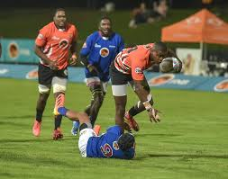
Problem Background
Data fragmentation, communication gaps, and manual processes.
Difficult to plan effective training programs

Slide 3


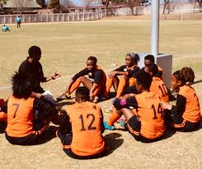
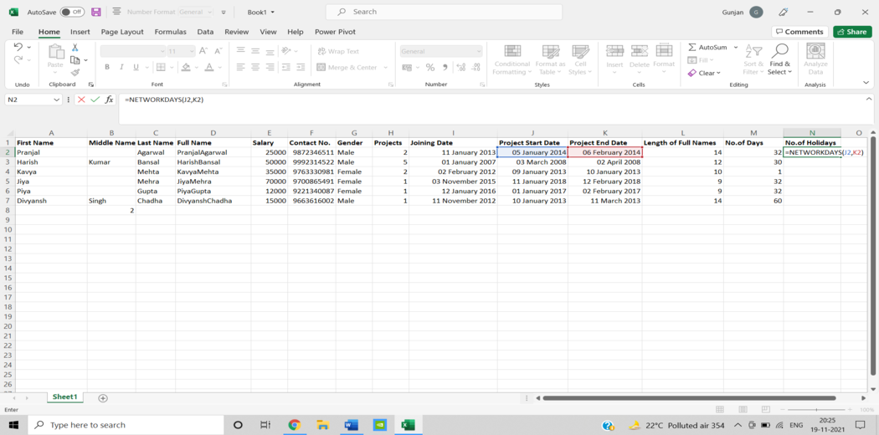
Problem Statement
Lack of integration, inefficient communication, and manual booking processes.
Data inaccuracy and redundancy, limited access to critical information, and inefficient injury management.
Limited coaching support.

Slide 4
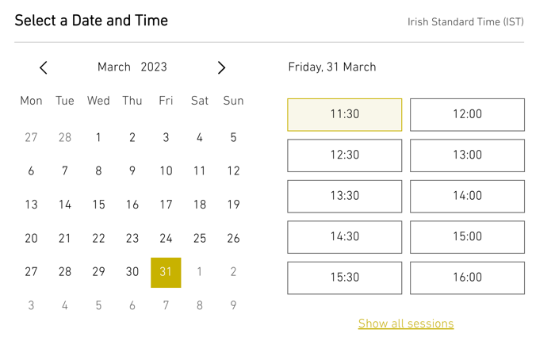
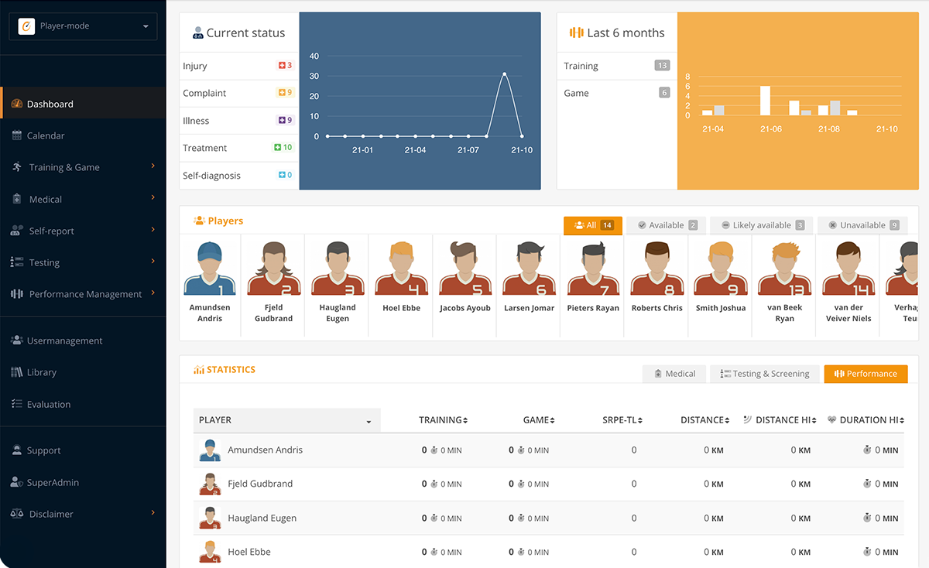
Proposed Solution
The UJ Sport Athlete and Booking Management System.
Comprehensive Athlete Profiles, Dynamic Scheduling, Performance Metrics, Virtual Injury Management, Interactive Coaching, Enhanced Team Management, Robust Reporting and Analytics.
Efficient booking systems for gym slots and transportation.

Slide 5
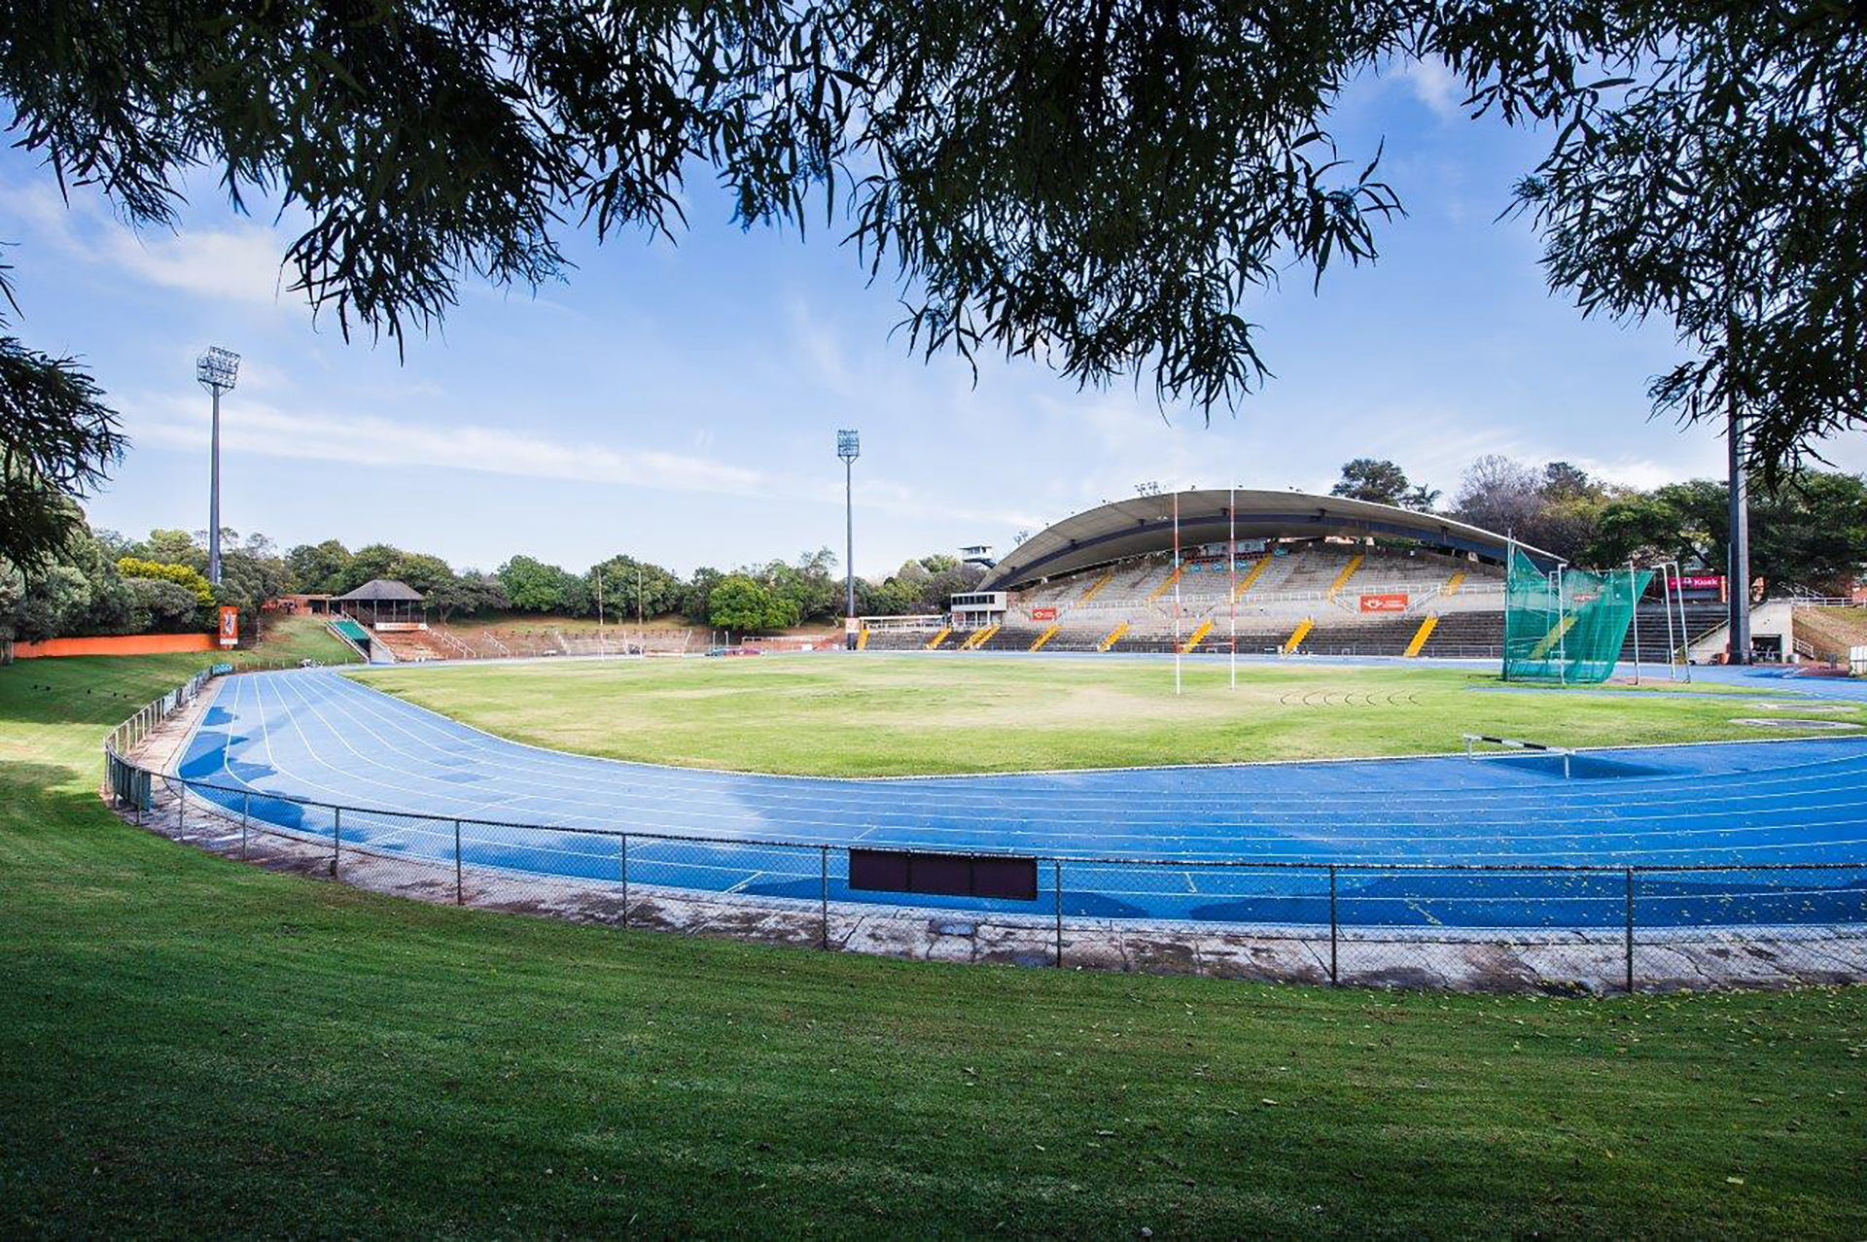


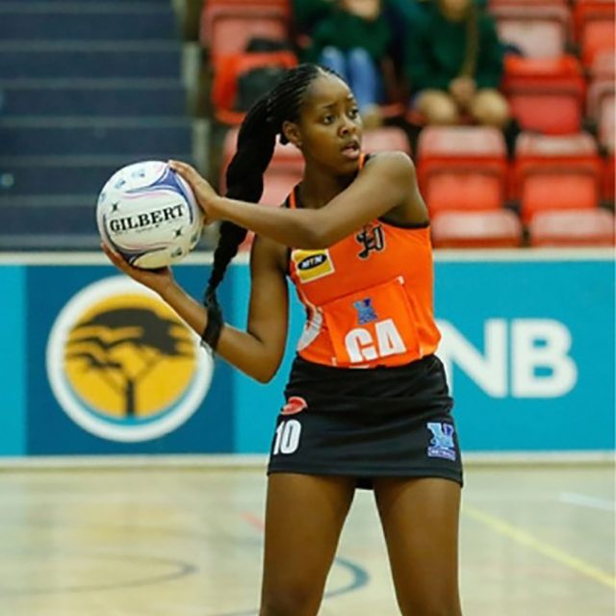
Actors
Athlete
Coach
Manager
Logistics Manager

